Slide 1
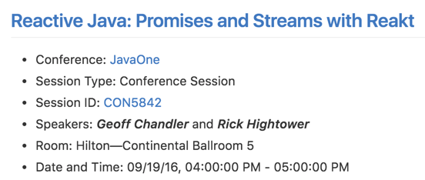
Notes:
These slides are from a talk we gave at JavaOne 2016 for work we did in the past, and open-source projects that we are working on.

Slide 2
Reactive Java: Promises and Streams with Reakt
Geoff Chandler and Rick Hightower

Slide 3
Speaker Introduction
Geoff Chandler (@SailorGeoff)
Rick Hightower (@RickHigh)

Slide 4
What is Reakt in 30 seconds!

Slide 5

Reakt
General purpose library for callback coordination and streams
Implements JavaScript style Promises and adapts them to a MT world
Can be used with
Reactor pattern systems,
actor system, event bus system,
and traditional forms of async Java programming
Lambda expression friendly
Notes:
10 seconds

Slide 6
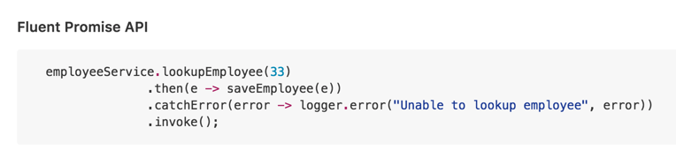

Fluent Lambda Friendly Promise API
Notes:
10 seconds

Slide 7
About the Project

Slide 8

Goals
Small and focused
Easy-to-use
Lambda friendly
Scalar async calls, and streams
Fluent
Evolve it (no change for the sake of change but get it right)
Semantic versioning
Notes:
Give example of not small
Looked at RXJava, Reactive Streams, Actors
Used Vert.x extensively
Not tied to QBit.

Slide 9
More Project Goals
Should work with
actor model
MT model
Reactor Pattern (event loop)
Supports
Async call coordination
Complex call coordination
and streams
Define interfaces and allow for other implementations
Allow core classes to be implemented by others

Slide 10
Problem: Async Coordination is Tricky
Results can comeback on foreign threads
Call several async services, one fails or times out? Now what?
Need to combine results of several calls before you can respond to the caller
What if a downstream service goes down?
What if your async handler throws an exception?
You can’t use a blocking future, or you will tie up the event handling thread
How do you test async services using a standard unit test framework?
Notes:
The headline is the slide, briefly cover the concepts.
Results can comeback on foreign threads If you need to call several services, what if one of them fails or times out? What if you need to combine the results of several calls before you can respond to the caller? What if a downstream service goes down? What if your async handler throws an exception? If you use a blocking future, you can tie up the event handling thread How do you test async services with a unit test framework?

Slide 11
Status
We use it often. We like it.
Integration libs for Guava, Vert.x, Netty (in the works), Kinesis, Cassandra, DynamoDB, etc.
Write async call handling for Lokate, and Elekt
QBit now uses it instead of its own callbacks and async coordination
Version 3.1 has major stability improvements (a lot of work was done)
Version 4 - Major update to simplify and refine interfaces (after JavaOne)
Won’t change how it is used, but will clean up the interfaces and simplify them
Delayed until after JavaOne (this will be version 4)

Slide 12
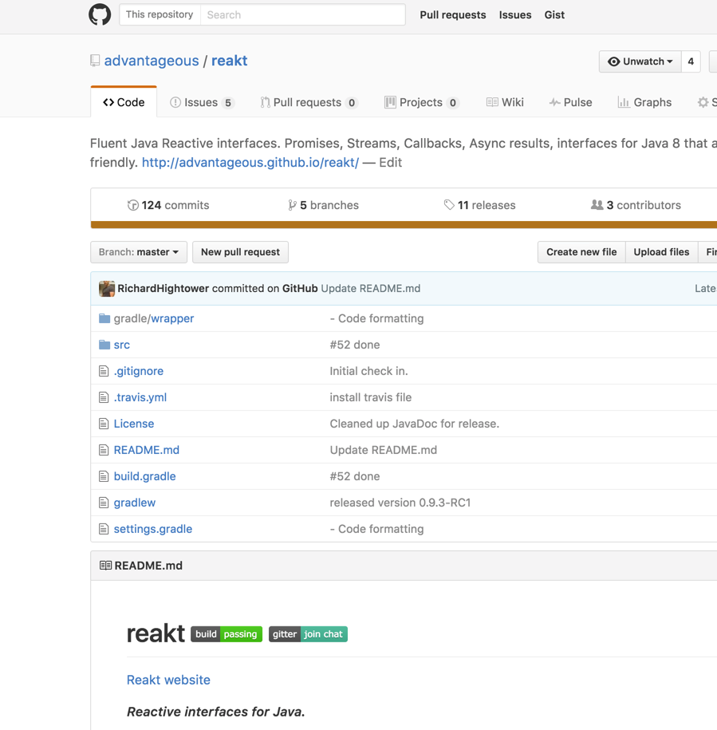
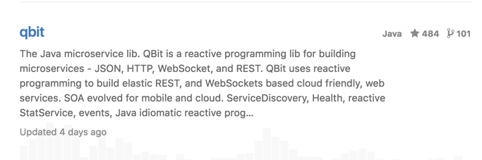
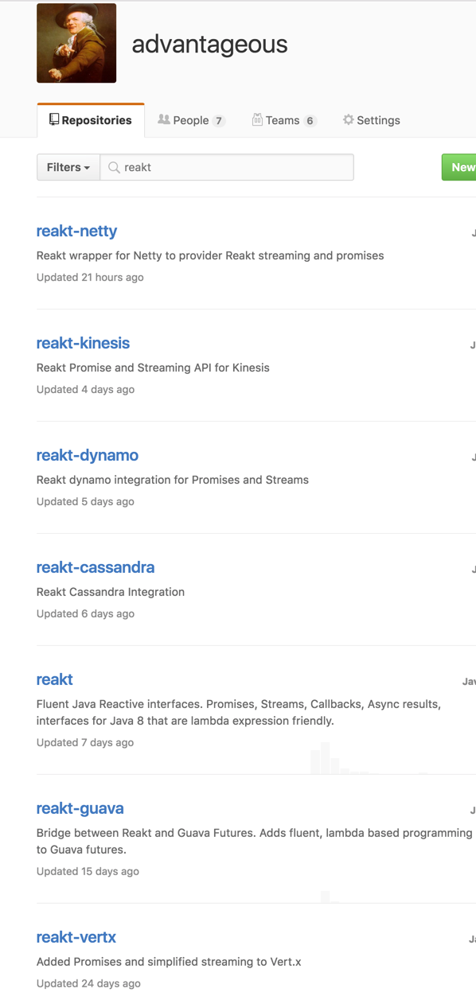

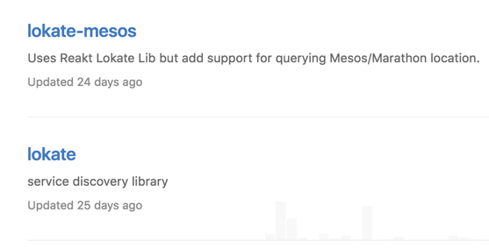
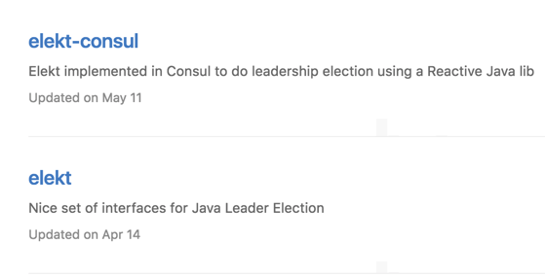
Open Source on GitHub - We use it
Notes:
The best way to improve a lib is to use it.
Many methods were added to simplify daily dev life.
Scratching our own itches.

Slide 13
How we got here. Why Promises?
Notes:
Each slide in this section is to be covered quickly. No more than 30 seconds per slide.

Slide 14
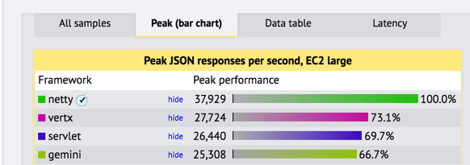
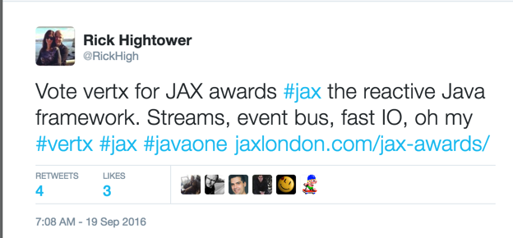
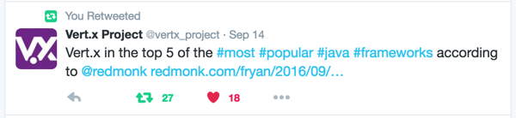
Implementations of Reactor Pattern
Browser DOM model and client side JavaScript
AWT/GTK+/Windows C API
Twisted - Python
Akka's I/O Layer Architecture
Node.js - JavaScript
Vert.x - (Netty)
Multi-Reactor pattern
Spring 5 Reactor
Reactor pattern frameworks do well in the IO performance wars and are typically at the top of the Techempower benchmarks

Slide 15

Our experience with Async, Reactor Pattern, and Actors
Worked with Actor system / high-speed messaging / PoCs (2011)
Used Vert.x to handle large amount of traffic on less resources (2012)
Wrote QBit to batch stream service calls to optimize thread-hand off and IO throughput (2013)
Needed high-speed call coordination for OAuth rate limiter (2014)
fronting many backend services
Worked on QBit Reactor but interface was better than before but still too complicated
Worked on many microservices in 12 factor cloud env - lots of async call coordination and circuit breaker - lots of retries (2015)
Worked on Vert.x / QBit project / Node.js project (2016)
Started using Node.js / JavaScript promises for client libs
Nice abstraction for dealing with async service calls
JS Promises were just right
Notes:
Geoff tells anecdotes about experience with ES6. Breaking a large monolithic Node.js app into microservices calling into services written in Java/Vert.x.
Picked Vert.x to handle large amount of traffic on fewer boxes for in-memory service
Vert.x + early QBit handled more load on 13 boxes than 2,000 boxes did for similar system
Created stream/batch, service actor system to simplify Vert.x dev (circa 2012/2013)
maximize throughput by minimizing IO and thread hand-off (QBit Java Microservices Lib)
Trial by fire, Callback coordination rough
Needed high-speed call coordination for OAuth rate limiter
fronting many backend services
Worked on QBit Reactor but interface was better than before but still too complicated
2016 - Worked on Vert.x / QBit project / Node.js project
Started using Node.js / JavaScript promises for client libs
Nice abstraction for dealing with async service calls
JS Promises were just right
We have been doing async callback coordination for some time. Using messaging, and handler ids, and streams, and reactor pattern, and all forms of async programming models.
It is clunky. We tend to think about things as Future. We tend to think in a MT world not a reactor, async, streaming world. Promises are a nice abstraction to not just reactor pattern but many forms of Java async programming. Having written three or four async callback handlers systems and not really liking any of them per se, and seeing the similarities to JS Promise but also seeing the eloquence of async promises, it seemed to make sense to adopt the terminology of JavaScript promises and the simplicity of it.
Picked Vert.x as our server to handle large amount of traffic on fewer boxes
Vert.x + early QBit allowed us to handle more load on 13 boxes than 2000 boxes on similar system at same company
Created stream/batch, service, actor system to simplify Vert.x dev (circa 2012/2013) and to maximize throughput by minimizing IO and thread hand-off (QBit Java Microservices Lib) - Trial by fire, Callback coordination rough.
Needed to do high-speed call coordination for OAuth rate limiter fronting many backend services - Worked on QBit Reactor but interface was better than before but clunky
2016 - Worked on Vert.x / QBit project and started writing integration libs
Started using Node.js / JavaScript promises
Nice abstraction for dealing with async service calls

Slide 16
Why async, responsive and reactive?
Reactive Manifesto - what is it and why it matters
Reactor Pattern - Most common form of reactive programming, adopts Promises
Microservices
Async programming prefered for resiliency
Avoiding cascading failures (“synchronous calls considered harmful”)
Async programming is key: How do you manages async call coordination?
Notes:
The point of this slide and the next is to make the claim that streaming is not the only way to do reactive programming.
The most common form of reactive programming is the reactor pattern / event loop, i.e., Browser DOM, Node.JS, Twisted and Vert.x.
Streaming fits many problem domains but so do service calls which are also more common.
Also streaming can be an implementation detail (as you can stream calls and stream responses).
If streaming is not the only way to handle async programming and not even the most common, what / how to people do service style programming and what tools do they use.
Node.js and Browser DOM JS are the two most common forms of async programming and they use Promises.
Akka has promises, Netty has promises, Vert.x has async result which is similar and QBit had something like promises before Reakt.
Reakt attempts to be separate from any particular implementation to focus on being a good promise lib for any sort of async programming in Java.
From Microservices paper by Martin Fowler et al: “Synchronous calls considered harmful: Any time you have a number of synchronous calls between services you will encounter the multiplicative effect of downtime. Simply, this is when the downtime of your system becomes the product of the downtimes of the individual components. ...” http://martinfowler.com/articles/microservices.html

Slide 17
Why the Semantics of ES6 Promises?

Slide 18
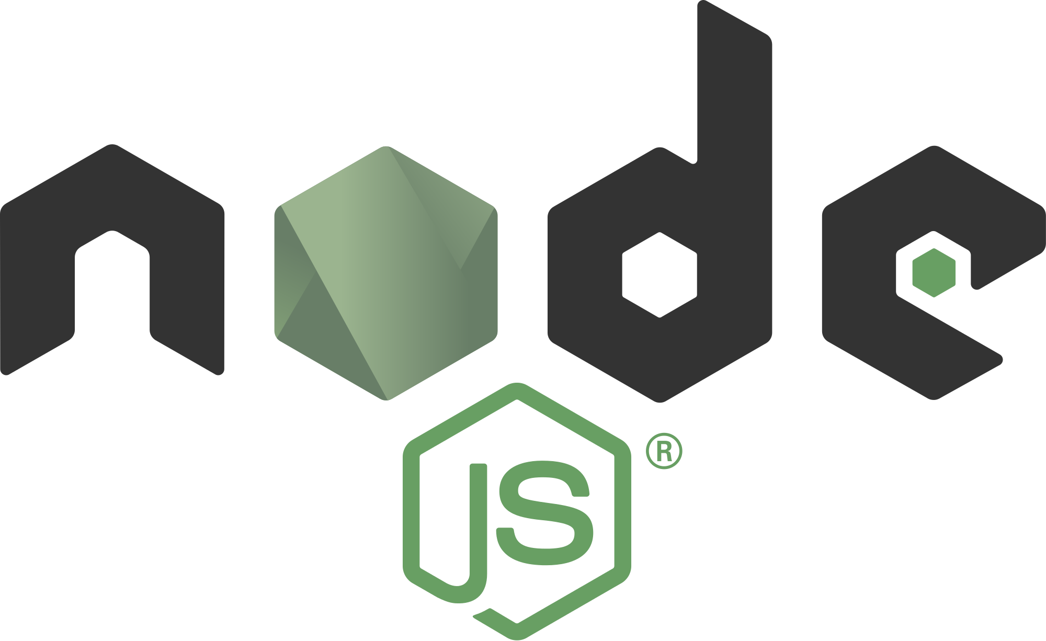

Reactor Pattern
Reactor pattern:
event-driven,
handlers register for events,
events can come from multiple sources,
single-threaded system - for handling events
handles multiple event loops
Can aggregate events from other IO threads
What is the most popular Reactor Pattern ecosystem? Oldest? Most common? Who has to live, breathe and sleep async calls? What do they use? Most popular Java one?
Notes:
“The reactor design pattern is an event handling pattern for handling service requests delivered concurrently to a service handler by one or more inputs. The service handler then demultiplexes the incoming requests and dispatches them synchronously to the associated request handlers.” https://en.wikipedia.org/wiki/Reactor_pattern
“The Reactor pattern has been introduced in [Schmidt95] as a general architecture for event-driven systems. It explains how to register handlers for particular event types, and how to activate handlers when events occur, even when events come from multiple sources, in a single-threaded environment. In other words, the reactor allows for the combination of multiple event-loops, without introducing additional threads.” http://www.cs.vu.nl/~eliens/online/oo/I/2/reactor.html

Slide 19
Promise from most popular Reactor system
AHA : This looks nice and makes sense
JS client side most popular reactor pattern of all time
What does JavaScript use to simplify async callback coordination?
Promises!
Node.js
Most popular server-side reactor pattern, and growing
What does JavaScript use to simplify async callback coordination?
Promises!
Reakt was born!

Slide 20

AHA Moment!
Wrote client libs in Java with Reakt Promises and ES6 (JavaScript) with/Promises
Code looked very similar
Semantics were same
Slight syntactic differences
“Wow!” That is clean
Hard to look at old way
Notes:
A good anecdote would be good here.
Having multiple projects open.
Loading the wrong one. Thinking it is the Java client when it was the JavaScript client.
Wrote client libs in Java with Reakt Promises and ES6 (JavaScript) with Promises
Code looked very similar
Semantics were same
Slight syntactic differences
We were both “Wow!” That is clean
It became hard to look at old way

Slide 21
Reakt Details

Slide 22
Reakt Concepts
Promise: Handler for registering events from an async call
Callback: Handler for resolving responses to an async call (scalar async result) / Mostly internal
Stream: Like a Callback but has N numbers or results (stream of results)
Breaker: Async circuit breakers
Expected: Results that could be missing
Reactor: Replays callbacks on Actor, Verticle or event handler thread (event loop)
repeating tasks, delay tasks
Result: Async result, success, failure, result from a Callback or Stream
Notes:
10 seconds.. We cover this again in detail

Slide 23
Promise

Slide 24
Promise Concepts
Like ES6 promises can be:
Completed States:
Resolved: callback/action relating to the promise succeeded
Rejected: callback/action relating to the promise failed
When a promise has been resolved or rejected it is marked completed
Completed: callback/action has been fulfilled/resolved or rejected
Notes:
This has been adapted from this article on ES6 promises. A promise can be:
fulfilled The callback/action relating to the promise succeeded
rejected The callback/action relating to the promise failed
pending The callback/action has not been fulfilled or rejected yet
completed The callback/action has been fulfilled/resolved or rejected
Java is not single threaded, meaning that two bits of code can run at the same time, so the design of this promise and streaming library takes that into account.

Slide 25
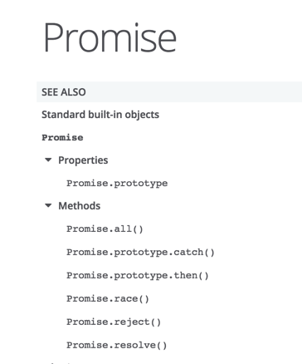
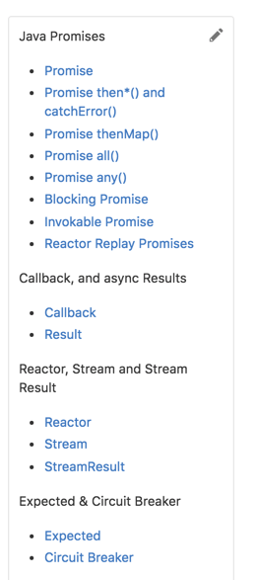
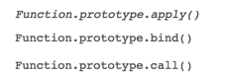
ES6 Promise vs Reakt

Slide 26
Special concerns with Java MT
JavaScript is single-threaded - Java is not.
Three types of Reakt promises:
Callback promises (async) (Promise)
Blocking promises (for unit testing and legacy integration) (BlockingPromise)
Replay promises (ReplayPromise)
allow promises to be handled on the same thread as caller
Works with Vert.x verticles, QBit service actors, other actors and even bus reactor (Netty)
Replay promises can have timeouts
Promises in Reakt can be invokeable which allow for a fluent registry of handlers before invocation
Notes:
JavaScript is single-threaded - You can make call, then register for callbacks and that is ok because call won’t be made until event loop moves on. Not so in Java! Java is MT to the core.
Java is not single threaded, meaning that two bits of code can run at the same time, so the design of this promise and streaming library takes that into account.
There are three types of promises:
Callback promises
Blocking promises (for testing and legacy integration)
Replay promises (allow promises to be handled on the same thread as caller)
Replay promises are the most like their JS cousins. Replay promises are usually managed by the Reakt Reactor and supports environments like Vert.x and QBit. See the wiki for more details on Replay promises.
It is common to make async calls to store data in a NoSQL store or to call a remote REST interface or deal with a distributed cache or queue. Also Java is strongly typed so the library that mimics JS promises is going to look a bit different. We tried to use similar terminology where it makes sense.
Events and Streams are great for things that can happen multiple times on the same object — keyup, touchstart, or event a user action stream from Kafka, etc.
With those events you don't really care about what happened before when you attached the listener.
But often times when dealing with services and data repositories, you want to handle a response with a specific next action, and a different action if there was an error or timeout from the responses. You essentially want to call and handle a response asynchronously and that is what promises allow.
This is not our first time to bat with Promises. QBit has had Promises for a few years now. We just called them CallbackBuilders instead. We wanted to use more standard terminology and wanted to use the same terminology and modeling on projects that do not use QBit like Conekt, Vert.x, RxJava, and reactive streams.
At their most basic level, promises are like event listeners except:
A promise can only succeed or fail once. A promise cannot succeed or fail twice, neither can it switch from success to failure. Once it enters its completed state, then it is done.

Slide 27
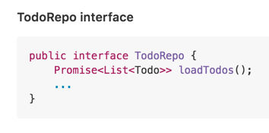
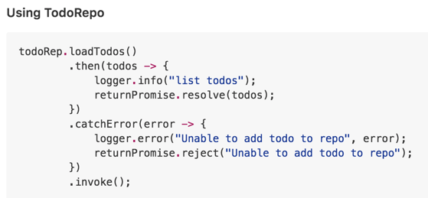
Using Promise

Slide 28
Handler methods
then() - use handle result of async calls
thenExpected() - use handle async calls whose result could be null
thenSafe() - like then but handles exception from handler
thenSafeExpected() - same as thenSafe but result could be null
catchError() - handles an exception
Notes:
thenExpect and thenSafeExpect
The handlers thenExpect and thenSafeExpect return a Reakt Expected instance. Expected is like Option in Java 8, it has methods like map, filter, etc. and adds methods ifEmpty, isEmpty. This gives a nice fluent API when you don't know if a successful return is null or not.
then and thenSafeExpect
The methods then and thenSafe async return the result that is not wrapped in an Expected object, i.e., the raw result. Use then and thenSafe when you know the async return will not be null. Use thenExpect and thenSafeExpect if the value could be null or if you want to map or filter the result.
thenMap
Use thenMap when a promise returns for example a List<Employee>, but you only want the first Employee. See Promise.thenMap for more details.
safe thenSafe thenSafeExpect
Unless you are using a reactor, custom Promises or blocking promises, the then* handlers will typically run in a foreign thread and if they throw an exception depending on the library, they could get logged in an odd way. If you think your handler could throw an exception (not the service you are calling but your handlers), then you might want to use thenSafe or thenSafeExpect. These will wrap your async then* handler code in a try/catch and pass the thrown exception to a ThenHandlerException to catchError. If your code ever hangs when making an async call, try using a thenSafe or thenSafeExpect. They ensure that any exceptions thrown in your handler don't get dropped by the system you are using, which could indicate a lack of understanding of the async lib you are using or that you are using it wrong. If it hangs, try thenSafe or thenSafeExpect. They help you debug async problems.

Slide 29
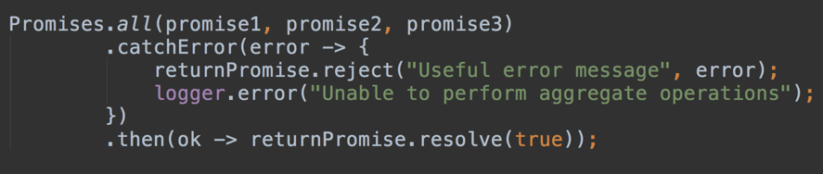
Promises.all
Promises.all(promises)
You create a promise whose then or catchError trigger (it resolves) when all promises passed async return (all resolve)
If any promise fails, the all promise fails
Notes:
We have all functionality with promises. You can create a promise that waits (async triggers) on all promises passed to it to be async returned.
The Promise.all(list or array) method returns a promise that resolves when all of the promises have resolved, or rejects with the reason of the first passed promise that rejects.

Slide 30
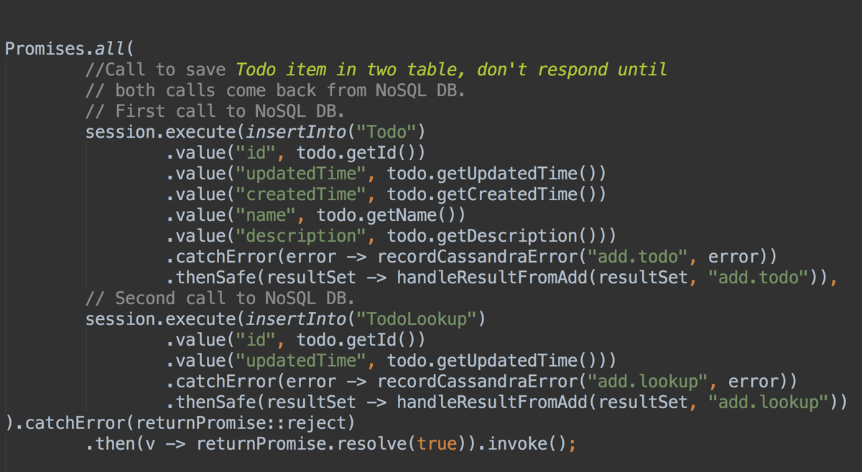
Promises.all
Notes:
This example is from the lab. It saves a Todo item into two tables into cassandra.
If either promise fails, the all promise fails.
If they both succeed, the all promise succeeds.
If every promise you pass to a promise is invokeable then the all promise is invokeable as well, and calling invoke on it will invoke all of the children promises.

Slide 31
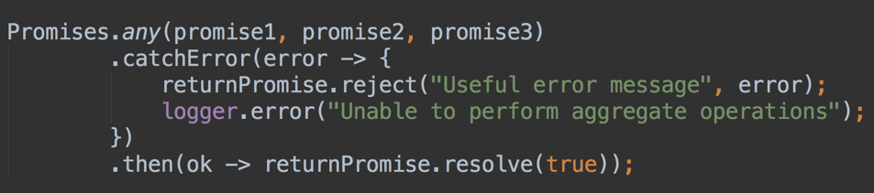
Promises.any
Promise.any(promises)
Creates promise that resolves or rejects
as soon as one of the promises resolves
Notes:
Promise.any(promises...) method returns a promise that resolves as soon as one of promises resolves. It will ignore errors from any of the other promises as long as they don’t all error.
It is similar but different than Promises.race from JavaScript. Many JS libs have an any equiv. Promise.race does not seem as useful as Promsie.any, but we might add Promise.race as well.

Slide 32
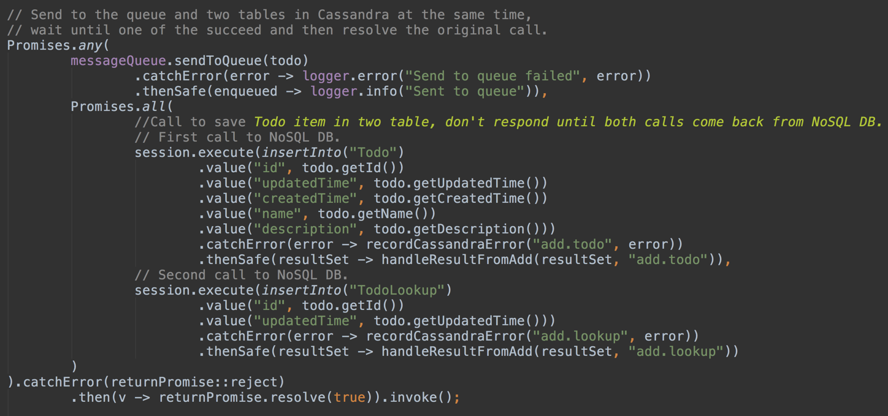
Promises.any() and Promise.all()

Slide 33
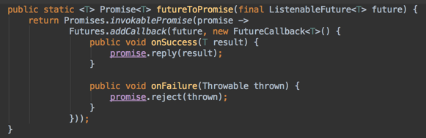
Promises.invokeablePromise (Reakt-Guava)
Notes:
This is an example of adapting a Guava style future handling to Reakt so you can use fluent promises with Cassandra.
Guava gets used by many libraries for its async support. Many NoSQL drivers use Guava, e.g., Cassandra.
Guava is JDK 1.6 backwards compatible.
Reakt provides composable promises that support lambda expressions, and a fluent API.
This bridge allows you to use Reakt's promises, reactive streams and callbacks to have a more modern Java experience with libs like Cassandra and other libs that use Guava.

Slide 34
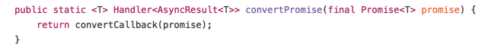
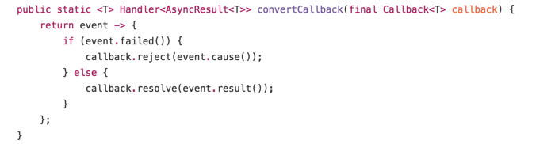
Easy to integrate w/ async libs - reakt-vertx
Notes:
The above shows adapting a Vert.x async handler to a Reakt promise.
We used this quite a bit.

Slide 35
Reactor

Slide 36
Reactor
Manages callbacks (ReplayPromises) that execute in caller's thread (thread safe, async callbacks)
Promise handlers that are triggered in caller’s thread
Timeouts for async calls
Manages tasks that run in the caller's thread
Repeating tasks that run in a caller's thread
one shot timed tasks that run in the caller's thread
Adapts to event loop, Verticle, Actor
Notes:
Reactor is similar to QBit Reactor (but cleaner, 2nd attempt) or Vert.x Verticle context.
The Reactor is a class that enables
callbacks that execute in caller's thread (thread safe, async callbacks)
tasks that run in the caller's thread
repeating tasks that run in a caller's thread
one shot after time period tasks that run in the caller's thread
The reakt Reactor is a lot like the QBit Reactor or the Vert.x context. It allows you to enable tasks that run in that actors or verticles thread.
The reakt Reactor creates replay promises. Replay promises execute in the same thread as the caller. They are "replayed" in the callers thread.
QBit implements a service actor model (similar to Akka type actors), and Vert.x implements a Reactor model (like Node.js).
QBit, for example ensures that all method calls are queued and handled by the service/actor thread. You can also use the QBit Reactor to ensure that callbacks happen on the same thread as the caller. This allows you callbacks to be thread safe. The Reakt Reactor is a drop in replacement for QBit Reactor except that the Reakt Reactor uses Reakt Promises, asyncResults and Callbacks. QBit 2 and Conekt will use Reakt's API and not its own.
You can use the Reakt Reactor with RxJava, Vert.x, or Spring Reactor and other similar minded projects to manage repeating tasks, tasks, and callbacks on the same thread as the caller (which you do not always need to do).
The Reactor is just an interface so you could replace it with an optimized version.

Slide 37
Notable Reactor Methods
addRepeatingTask(interval, runnable) add a task that repeats every interval
runTaskAfter(afterInterval, runnable) run a task after an interval expires
deferRun(runnable) run a task on this thread as soon as you can
all(...) creates a all promise; resolves with Reactor (you can pass a timeout)
any(...) create any promise with Reactor (you can pass a timeout)
promise() creates a ReplayPromise so Reactor manages promise (you can pass a timeout)
Notes:
Reactor Methods of note
Here is a high level list of Reactor methods.
addRepeatingTask(interval, runnable) add a task that repeats every interval
runTaskAfter(afterInterval, runnable) run a task after an interval expires
deferRun(Runnable runnable) run a task on this thread as soon as you can
static reactor(...) create a reactor
all(...) create a promise that does not async return until all promises async return. (you can pass a timeout)
any(...) create a promise that does not async return until one of the promises async return. (you can pass a timeout)
process process all tasks, callbacks.
Here is the Reactor interface that can be implemented by anyone.
Promise invokeWithReactor (shorthand) runas replay on reactor

Slide 38
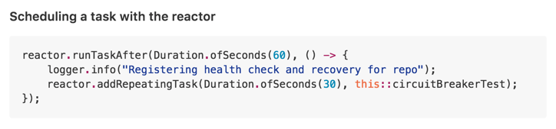
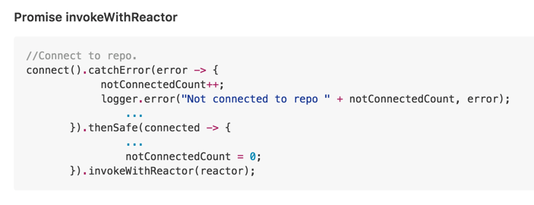
Notes:
This might be a good slide to actually pull up the invokeWithReactor code and show what it is doing.

Slide 39
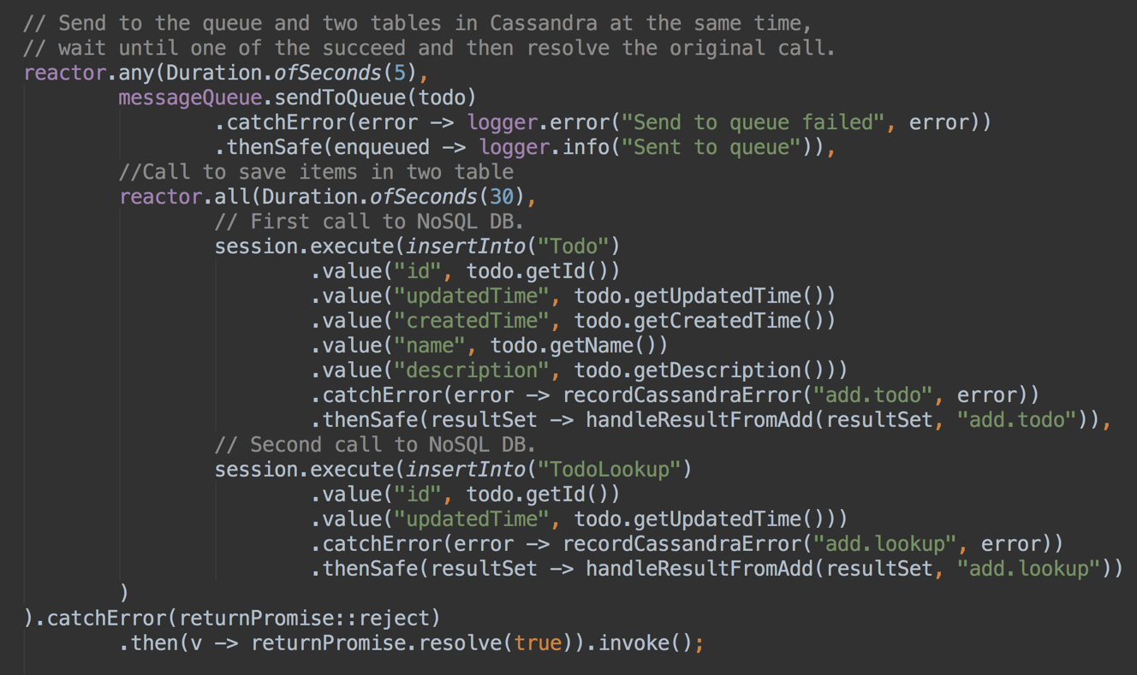
Reactor, any, all, timeouts
Promise to queue
Promises to store todo in NoSQL tables
Notes:
This slide might make more sense now.

Slide 40
Circuit breaker

Slide 41
Circuit Breaker
Breaker is short for circuit breaker
Wraps access to a service, resource, repo, connection, queue, etc.
Tracks errors which can trigger the breaker to open
Breaker is just an interface / contract
Implementers can be creative in what is considered an open or broken breaker
Notes:
A Breaker is short for Circuit Breaker. The idea behind the breaker is to wrap access to a service so that errors can be tracked and the circuit breaker can open if errors are exceeded. Like all things in Reakt there is an interface for Breaker that defines a contract but other implementations can get creative on how they detect the Breaker has been thrown.

Slide 42
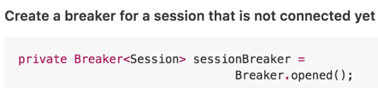
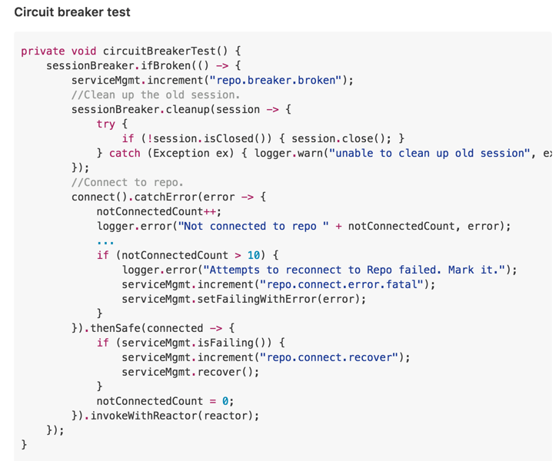
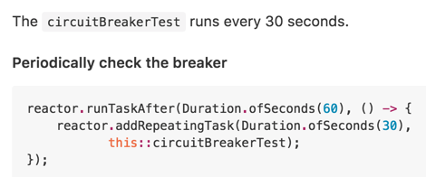
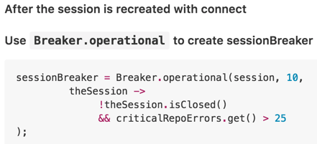
Come to the lab tomorrow to
See a full use case using
Async circuit breakers
Notes:
In this example we are using this with a database connect, but imagine this could be a downstream REST client or a downstream WebSocket client.
It has been our experience, especially in cloud environments. That downstream clients can be restarted and they not only have to be reconnected to, but they may have to be relooked up in DNS or some other form of client discovery. They may have moved addresses entirely.
@Override
public Promise<Boolean> connect() {
return invokablePromise(promise -> {
serviceMgmt.increment("connect.called");
discoveryService.lookupService(cassandraURI).thenSafe(cassandraUris -> {
serviceMgmt.increment("discovery.service.success");
final Builder builder = builder();
cassandraUris.forEach(cassandraURI1 -> builder.withPort(cassandraURI1.getPort())
.addContactPoints(cassandraURI1.getHost()).build());
futureToPromise(builder.build().connectAsync()) //Cassandra / Guava Reakt bridge.
.catchError(error -> promise.reject("Unable to load initial session", error))
.then(sessionToInitialize ->
buildDBIfNeeded(sessionToInitialize)
.thenSafe(session -> {
cassandraErrors.set(0);
sessionBreaker = Breaker.operational(session, 10, theSession ->
!theSession.isClosed() && cassandraErrors.incrementAndGet() > 25
);
promise.resolve(true);
})
.catchError(error ->
promise.reject(
"Unable to create or initialize session", error)
).invokeWithReactor(reactor)
).invokeWithReactor(reactor);
}).catchError(error -> serviceMgmt.increment("discovery.service.fail")).invokeWithReactor(reactor);
});
}

Slide 43
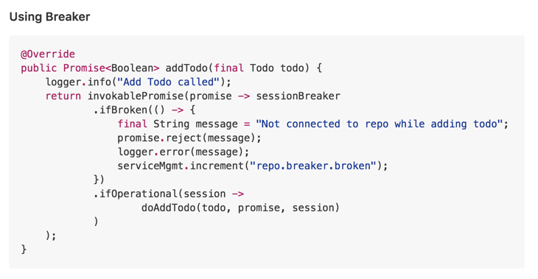
Using breaker

Slide 44
Blocking promises

Slide 45
Blocking promises
Legacy integration
Unit testing
Prototypes
Batch jobs that don’t need async
(so you don’t have to have two libs)
Notes:
A BlockingPromise is very much like a Java Future. It is blocking. This is useful for unit testing and for legacy integration.
Promises returns a blocking promise as follows:
Blocking Promise
/**
* Create a blocking promise.
* NOTE BLOCKING PROMISES ARE FOR LEGACY INTEGRATION AND TESTING ONLY!!!
* After you create a promise you register its then and catchError and then you use it to
* handle a callback.
*
* @param <T> type of result
* @return new promise
*/
static <T> Promise<T> blockingPromise() {
return new BlockingPromise<>();
}

Slide 46
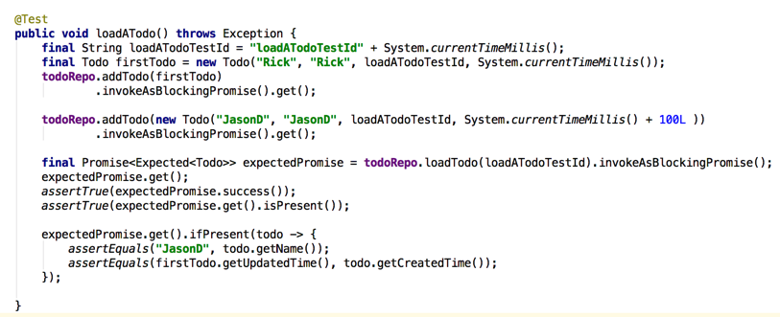
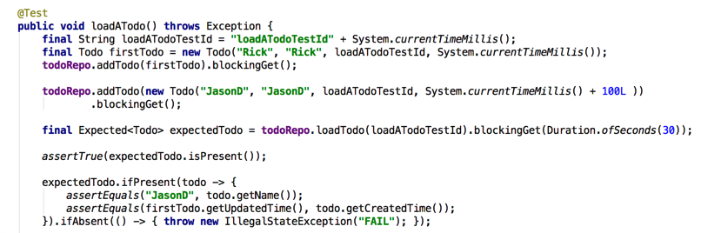
Unit test using blocking promise using invokeAsBlockingPromise then blockingGet
Notes:
You could show what invokeAsBlockingProimse looks like.
Show the actual code.
The second code listing shows how to use an expected as well.

Slide 47
Stream

Slide 48
Stream
Handler for N results
While a Callback and Promise is for one Result, a Stream is for N results
Callback/Promise for Scalar returns
Stream is for many returns
Similar to Java 9 Flow, RxJava or Reactive Streams
Java 8/9 lambda expression friendly
(Fuller example as extra material on slide deck depending on time go to end of slide deck or just cover next two slides)
StreamResult, then(), catchError(), cancel(), request(count)
Notes:
Stream is a generic event handler for N results, i.e., a stream of results. This is a like a type of Callback for streaming results. While Callback can be considered for scalar results, a Stream is more appropriate for non-scalar results, i.e., Stream.onNext will get called many times.
StreamResult is a result of an async operations with optional methods for cancel and request more items.

Slide 49
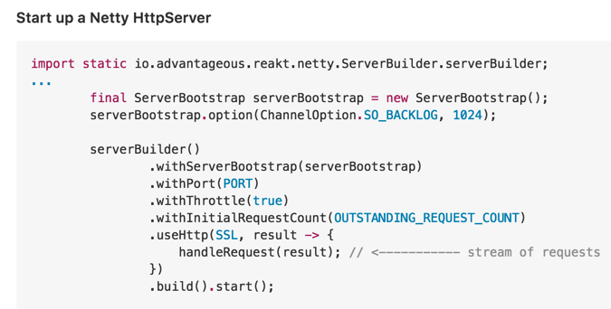
streamResult.cancel(), streamResult.request(count)

Slide 50
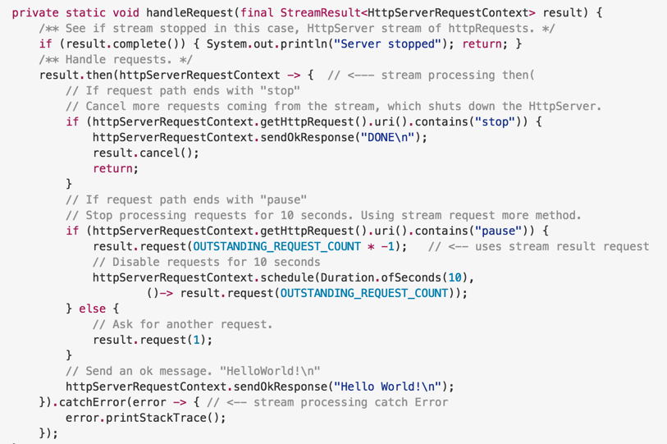
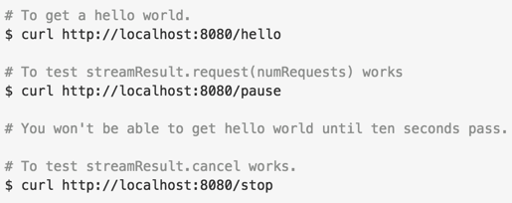
streamResult.cancel(), streamResult.request(count) (part 2)
Fuller
Examples
In Hands-On Lab
Come
Tomorrow
Notes:
Break it down

Slide 51
Example that combines Reakt: Reactor/Stream/Promises

Slide 52
Example Recommendation Service
Recommendation service
Watch what user does, then suggest recommended items
Recommendation service runs many recommendation engines per microservice

Slide 53
Worked example will show
User recommendation service
Delay giving recommendations to a user until that user is loaded from a backend service store
Users are streamed in (uses streams)
Stream comes in on foreign thread and we use reactor to move handler to service actor thread
If user is already in service actor, then recommend a list of recommendations right away
If user not in system, batch load user from backend service store
Requests are batched to reduce IO overhead
Users can come from many sources from service store (cache, disk cache, DB), and are delivered as soon as found in a continuous stream of user lists

Slide 54
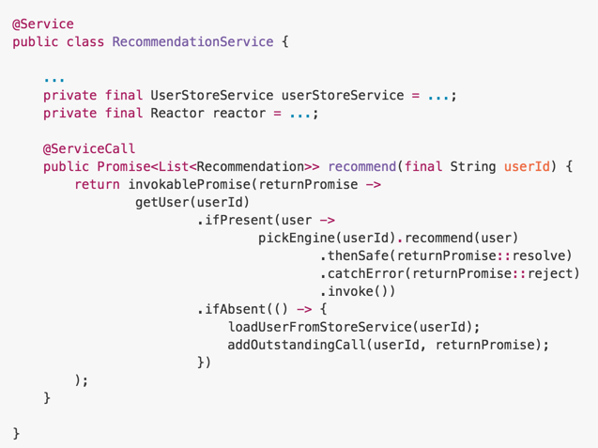
Async call recommendation engine if user present
If not add user id to call batch, add to outstanding call for user.

Slide 55
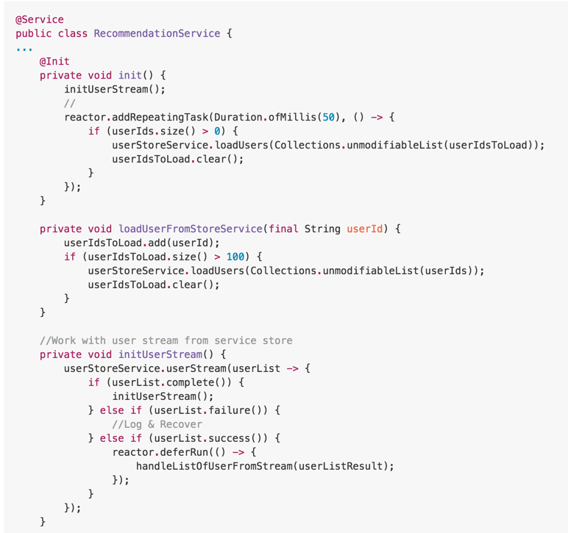
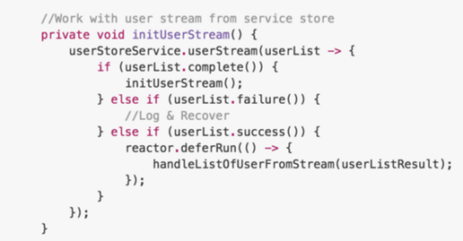
Every 50 ms check to see if the
userIdsToLoad is greater than 0,
If so request those users now.
When a user is not found loadUserFromStoreService is called. If there are 100, outstanding requests, then load those users now.
Listen to the userStoreService’s
userStream

Slide 56
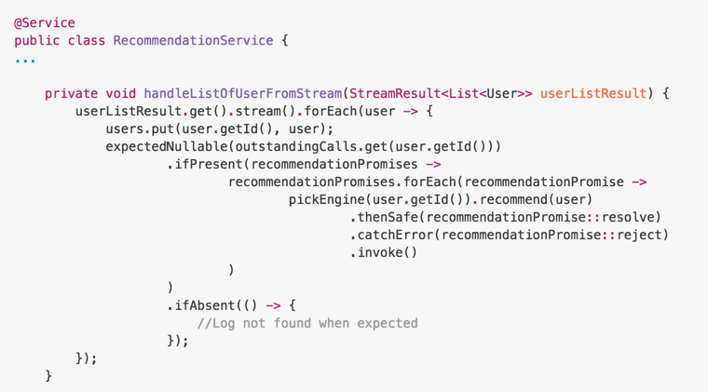
Process the stream result.
Populate the user map (or use a Simple cache with an expiry and a max number of users allowed to be in system).
Since the user is now loaded, see if their are outstanding calls (promises) and resolve those calls.

Slide 57
Next steps

Slide 58
Next steps
Get rid of invoke and detect when a frame drops (let Geoff explain this one)
Simplify interface for Promise/Callback Reakt 4.0
We use semantic versioning, but even from version to version so far interfaces are fairly compatible for 97% of use cases
More reakt libs ***
Refine streaming interface
Add more support for Vert.x reakt
Support streaming via Reakt
Create client wrappers, event bus wrapper, etc.
More integration libs
Spring Reactor, Servlet async, Java EE, JMS, Kafka, Reactive Streaming, Rxjava, Java 9 Flow

Slide 59
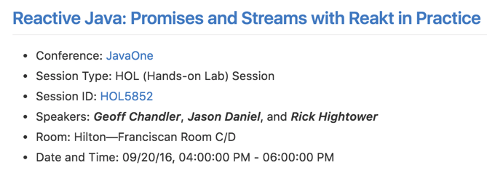
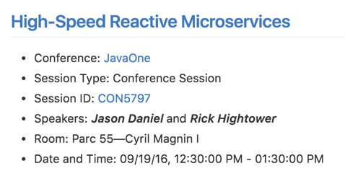
Related Talks

Slide 60
Conclusion
Reakt provides an easy-to-use lib for handling async callbacks
It uses Promise concepts from ES6 which seem well thought out and natural
We worked with many async libs and wrote a few our self, and really like the ES6 terminology and ease of use
Since Java is MT and JavaScript is not there are some differences
Java 8/9 lambda expression friendly
Async call coordination can be difficult but all promises, any promises, reactor with replay promises and timeouts make it easier
Reakt is evolving and we welcome feedback and contributions (bug reports, pull requests, articles, blogs, etc.)

Slide 61
Extra Material

Slide 62
Author Bio

Slide 63
Author Geoff Chandler
Senior Director at a large Media Company.
Works with Node.js, Cassandra, Mesos, QBit, EC2, and reactive programming. Major
Contributor to QBit, Spring Boot, Reakt, and more.
Creator of Lokate, ddp-client-java, guicefx, and various devops tools for gradle.

Slide 64
Author Bio Rick Hightower
Rick frequently writes about and develops high-speed microservices. He focuses on streaming, monitoring, alerting, and deploying microservices. He was the founding developer of QBit and Reakt as well as Boon.
Notes:
Recently, Rick help develop many resilient, fault-tolerant microservices running in a Heroku clone based on Mesos in Scala and Java. He adapted QBit, microservice lib, so that when you drop in a service, it hooks into all of the 12 factor features that Orchard supports. QBit plugs into Orchard, port binding, DNS discovery, KPI stats, monitoring/distributed logging, health system, etc. Rick also wrote support for API gateway services via built-in Swagger support. This allows generation of service docs as well as REST clients for Python, Ruby, Java, Scala, etc. For the JVM, you also get WebSocket client which are auto generated runtime stubs which can invoke 500K method calls (request response) over WebSocket a second (per thread). Rick also wrote the OAuth rate limiter microservice which does OAuth rate limiting by application id and service load balancing for another online media services. Before that Rick wrote a 100 million-user in-memory content preference engine microservice for a large media company with custom NoSQL service store (2014) as part of this effort he wrote high speed JSON REST/WebSocket framework for reactive computing model based on Boon and Vert.x (and a disk batcher capable of writing 720 MB per second—the disk batcher was later used by Beats). Rick wrote over 150,000+ lines of open source code in 2013 – 2016. Rick also contributed to the reference implementations of Grid Computing and enterprise caches as well as being a member of several spec. committees (JSR-347, JSR-107, etc.) Rick is the primary author of Boon, SlumberDB and QBit. Rick is author of the best-selling book Java Tools for Extreme Programming (#1 SW development book on Amazon for 3 months) and other books. Rick also wrote a book on Python that covered programming and OO basics which was used as college text for introduction to programming and software development. Rick setup computer science programs at an elementary school and taught classes for three years. "Rick has the distinction of writing the single most popular article/series ever published on the Java technology zone." --Jenni Aloi, IBM DeveloperWorks. Rick also wrote a book on Java Web Development, which is the number one download on TheServerSide.com, and he wrote about NoSQL and scalability on InfoQ, and was the NoSQL editor for a short period of time. Prior to becoming a consultant, Rick helped create a startup that hosted 2,000 online stores on commodity hardware.

Slide 65
Worked example
These are extra slides for a worked stream example

Slide 66
Example
Take from a real world scenario which gave birth to use using Vert.x, and later creating QBit and Reakt
Example uses Streams, and Promises
This is not the actual code from the actual project (this is just an example)

Slide 67
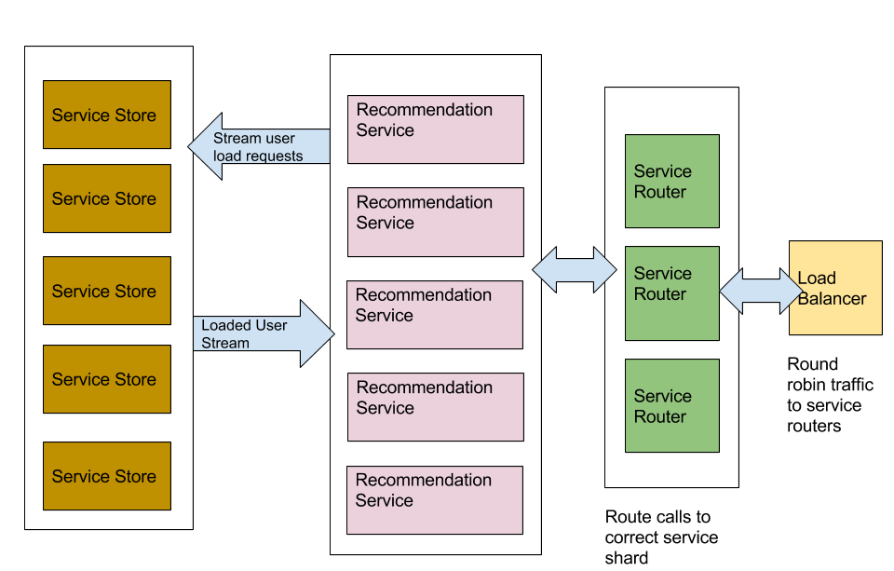
Block diagram of a HSRM system we built

Slide 68
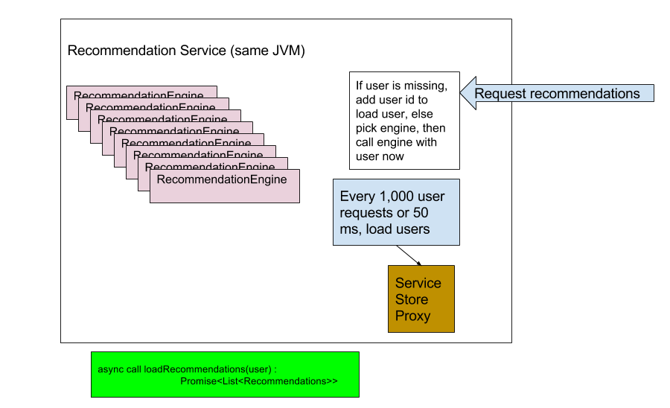

Slide 69
Async call recommendation engine if user present
If not add user id to call batch, add to outstanding call for user.

Slide 70
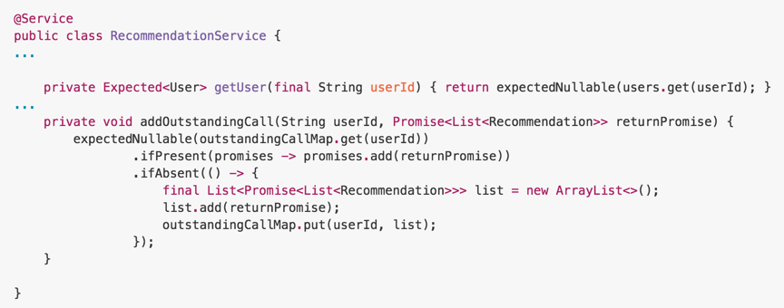
Adding an outstanding call (promise)

Slide 71
Every 50 ms check to see if the
userIdsToLoad is greater than 0,
If so request those users now.
When a user is not found loadUserFromStoreService is called. If there are 100, outstanding requests, then load those users now.
Listen to the userStoreService’s
userStream

Slide 72
Process the stream result.
Populate the user map (or use a Simple cache with an expiry and a max number of users allowed to be in system).
Since the user is now loaded, see if their are outstanding calls (promises) and resolve those calls.

Slide 73
Slides we pulled out

Slide 74
Streams vs Service Calls
Microservices / RESTful services / SOA services
REST / HTTP calls common denominator
Even messaging can be request/reply
Streams vs. Service Calls
Level of abstraction differences,
Calls can be streamed, Results can be streamed
What level of abstraction fits the problem you are trying to solve
Are streams an implementation details or a direct concept?
Notes:
The point of this slide and the previous is to make the claim that streaming is not the only way to do reactive programming.
The most common form of reactive programming is the reactor pattern / event loop, i.e., Browser DOM, Node.JS, Twisted and Vert.x.
Streaming fits many problem domains but so do service calls which are also more common.
Also streaming can be an implementation detail (as you can stream calls and stream responses).
If streaming is not the only way to handle async programming and not even the most common, what / how to people do service style programming and what tools do they use.
Node.js and Browser DOM JS are the two most common forms of async programming and they use Promises.
Akka has promises, Netty has promises, Vert.x has async result which is similar and QBit had something like promises before Reakt.
Reakt attempts to be separate from any particular implementation to focus on being a good promise lib for any sort of async programming in Java.

Slide 75
Related projects
QBit Java Microservice (built on top of Vert.x for IO)
Using Reakt reactor to manage callbacks,
REST and WebSocket services (WebSocket RPC) use Reakt Promises and Reakt Callbacks
Lokate - service discovery lib for DNS-A, DNS-SRV, Consul, Mesos, Marathon
Uses Reakt invokeable promises (Vert.x for IO)
Elekt - leadership lib that uses tools like Consul to do leadership election (uses promises)
Reakt-Guava - Reakt Bridge to Guava listable futures
Reakt-Vertx - Reakt Bridge for Vert.x AsyncCallbackHandler
Reakt-DynamoDB - Reakt wrapper for async DynamoDB
Reakt-Cassandra - Reakt wrapper for async Cassandra access
Reakt-Kinesis - Reakt wrapper for async Kinesis (under development)

Slide 76
Promise
Promises can be used for all manners of async programming
not just Reactor Pattern
You can use it with standard Java Lib
Bridges for Guava, Vert.x and Cassandra
QBit uses it (Service Actor/Microservices),
Lokate (Discovery),
Elekt (Leadership election),
Clean interface for dealing with async programming

Slide 77
Other Async Models
Messaging (Golang, Erlang, RabbitMQ, JMS, Kafka)
Actors (Erlang, Akka)
Active Objects (Akka types actors, DCOM)
Common problems when dealing with handling calls to services:
Handling the call

Slide 78
Reactor works with
Works with Reactor Architecture (Vert.x, Spring Reactor )
Works with Actor model and Active Objects (Akka actors, Akka typed actor, QBit, etc.)
ReplayPromises need a Reactor
Reactor is an interface
Replace it with one optimized for your environment
Or manage ReplayPromises and tasks with something else like a Reactor
Notes:
Works well with Reactor Architecture (Vert.x, Spring Reactor, )
Works well with Actor model and Active Objects (Akka actors, Akka typed actor, QBit, etc.)
ReplayPromises need a Reactor (or something that fulfills that role)
Reactor is just an interface so you can replace it with one optimized for your environment

Slide 79
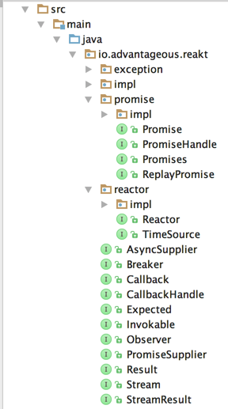
Review
Most of these
Should be familiar to you
Notes:
You can talk about changes in 4.0 and how we are simplifying the interface.

